Slide 1

SIZE INDEPENDENCE
Volume grows cubically.
The enucleation plane, only quadratically.
In HoLEP, enucleation takes place on the surface that separates the adenoma from the surgical capsule. That surface grows far more slowly than the volume, which is why a 500 cc prostate can be enucleated with the same endoscope as a 30 cc one.
Dr. Fernando Gómez Sancha
Instituto de Cirugía Urológica Avanzada · ICUA · Madrid
https://holep.icua.es/3d/en/
Free for teaching and outreach, citing the source: ICUA · holep.icua.es/3d

Slide 2
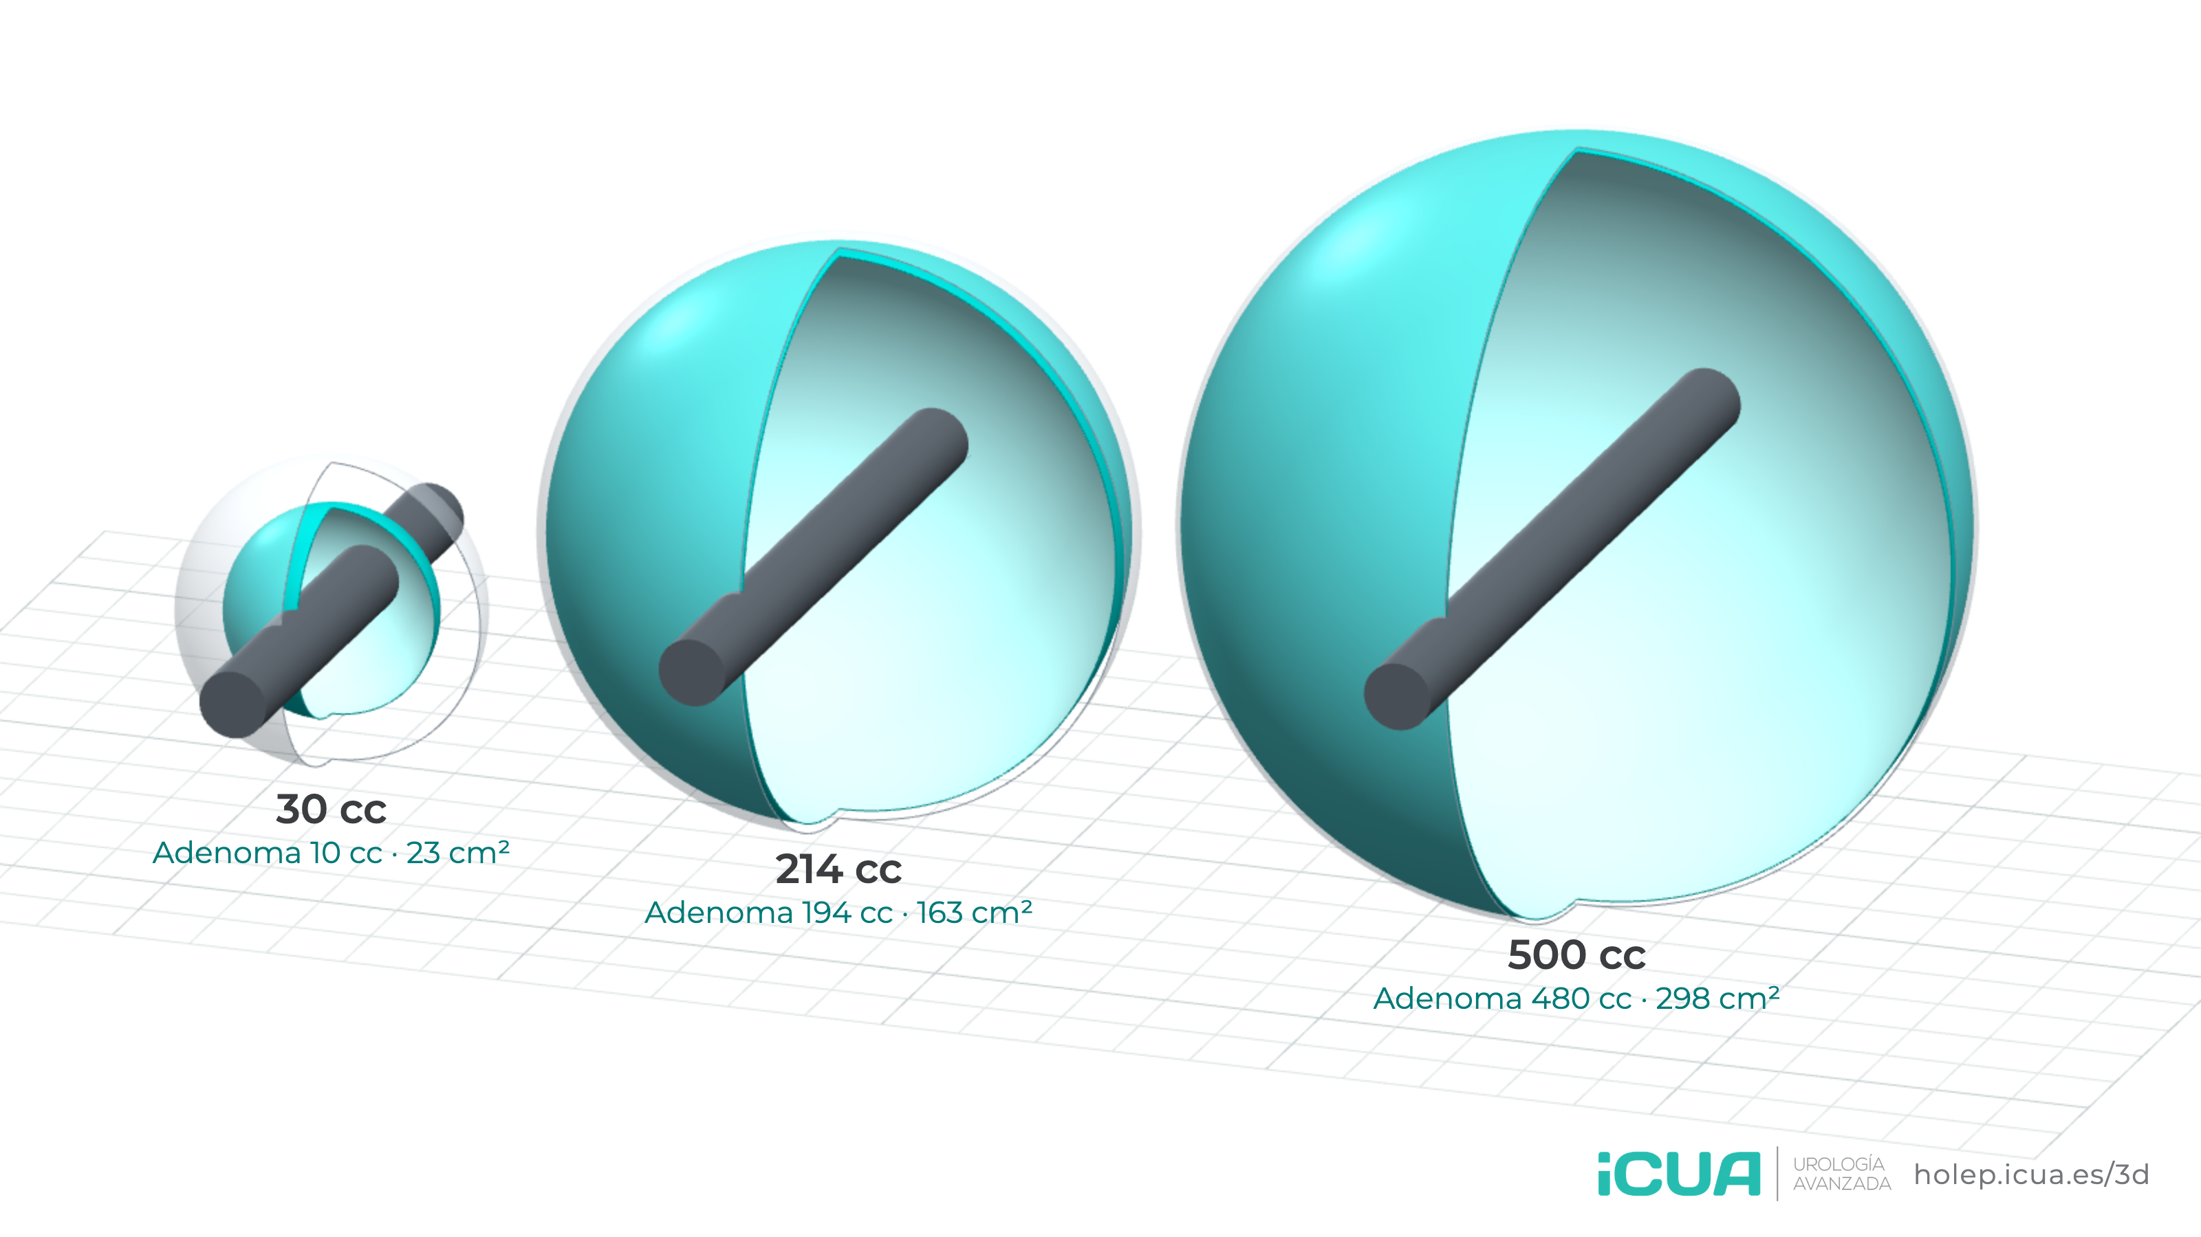
FROM 30 TO 500 CC
True scale, in 3D
×48
Adenoma enucleated
×13.2
Adenoma-capsule plane
×2.6
Diameter and length
■ Adenoma-capsule plane ■ Peripheral zone, ≈ 20 g, not removed ■ 26 Fr sheath
https://holep.icua.es/3d/en/ · Dr. Fernando Gómez Sancha · ICUA
2 / 7

Slide 3
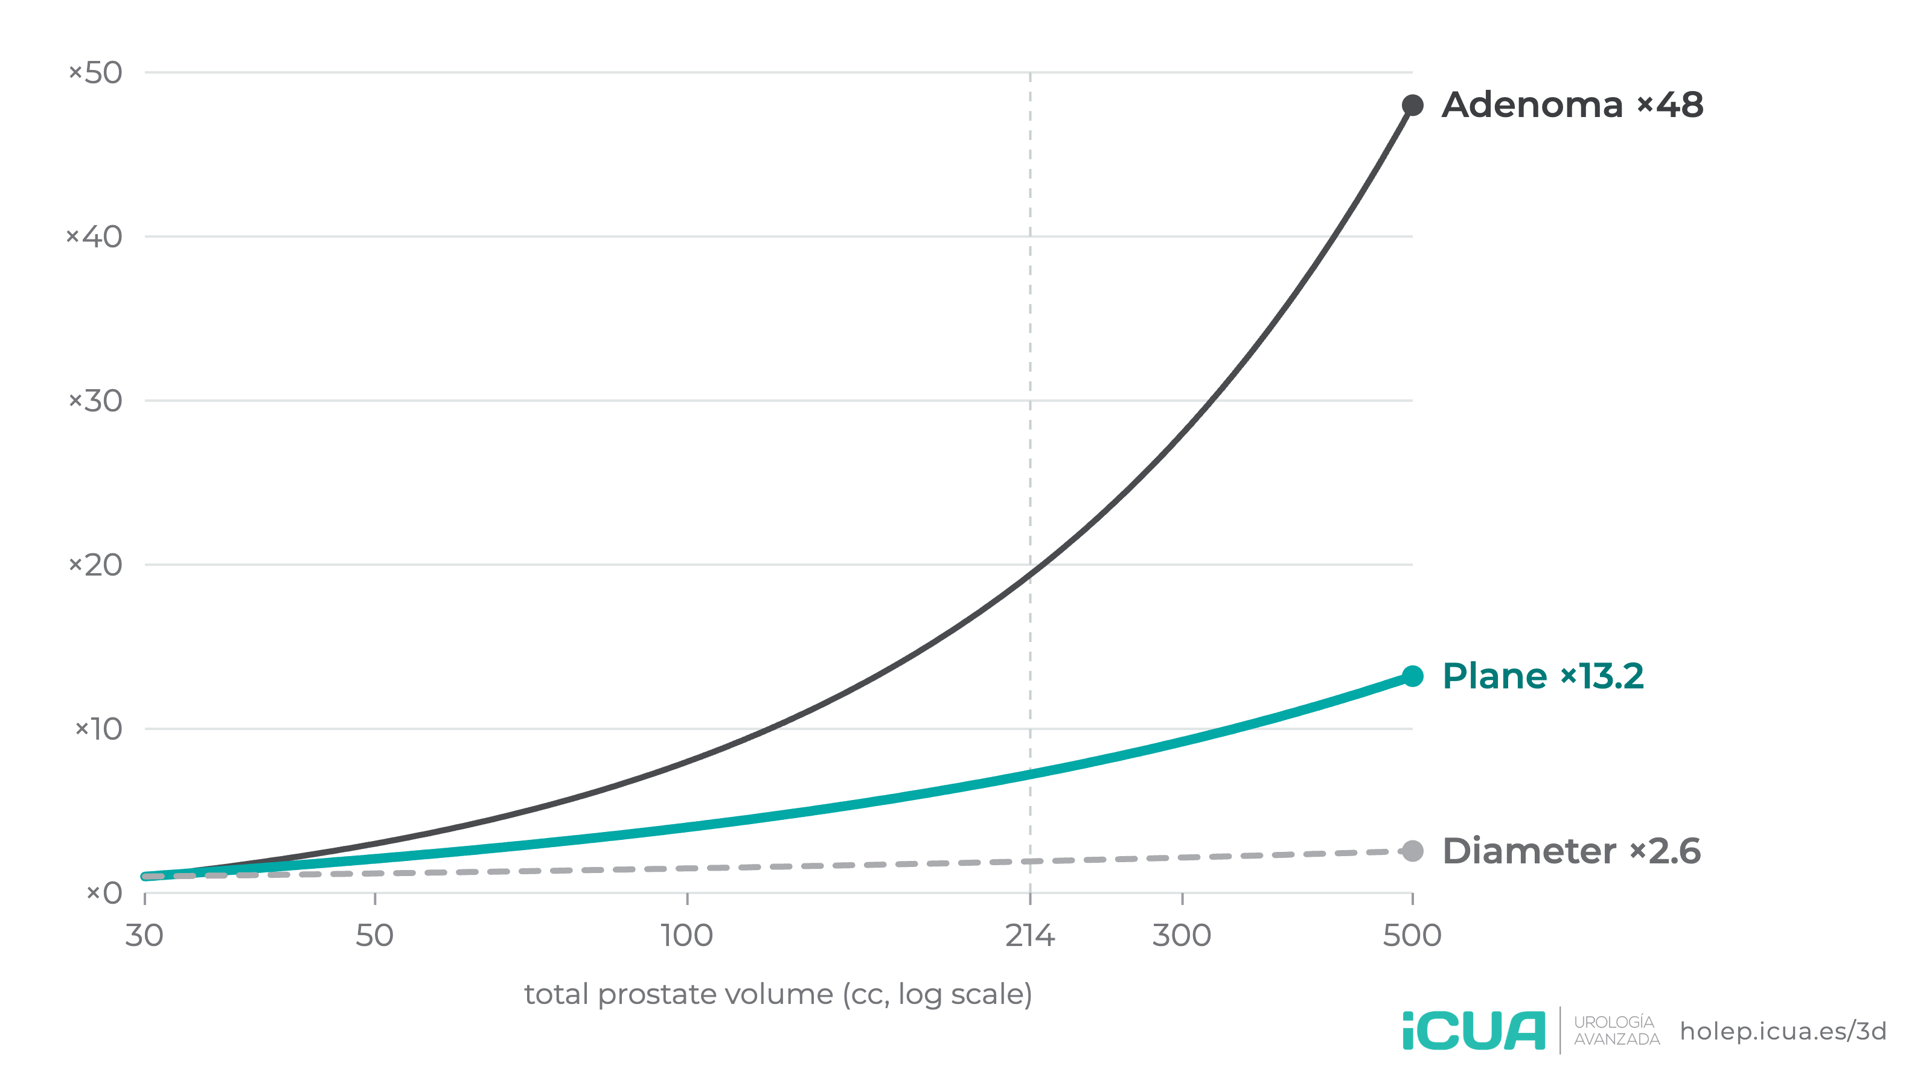
SIZE INDEPENDENCE
How each quantity grows
Multiplier relative to a 30 cc prostate, which has only about 10 cc of adenoma. The adenoma removed takes off; the plane's area increases gradually; the diameter barely changes.
https://holep.icua.es/3d/en/ · Dr. Fernando Gómez Sancha · ICUA
3 / 7

Slide 4
SIZE INDEPENDENCE
Dissection area per cc of adenoma
The larger the prostate, the less surface area has to be dissected for each cc of adenoma enucleated. For a 500 cc gland, the dissection area per cc is about a quarter of that of a 30 cc gland.
Total volume | Adenoma | Plane area | Area per cc of adenoma | Adenoma × | Plane ×
30 cc | 10 cc | 23 cm² | 2.26 cm² | ×1.0 | ×1.0
80 cc | 60 cc | 74 cm² | 1.24 cm² | ×6.0 | ×3.3
150 cc | 130 cc | 125 cm² | 0.96 cm² | ×13.0 | ×5.5
214 cc | 194 cc | 163 cm² | 0.84 cm² | ×19.4 | ×7.2
300 cc | 280 cc | 208 cm² | 0.74 cm² | ×28.0 | ×9.2
500 cc | 480 cc | 298 cm² | 0.62 cm² | ×48.0 | ×13.2
https://holep.icua.es/3d/en/ · Dr. Fernando Gómez Sancha · ICUA
4 / 7

Slide 5
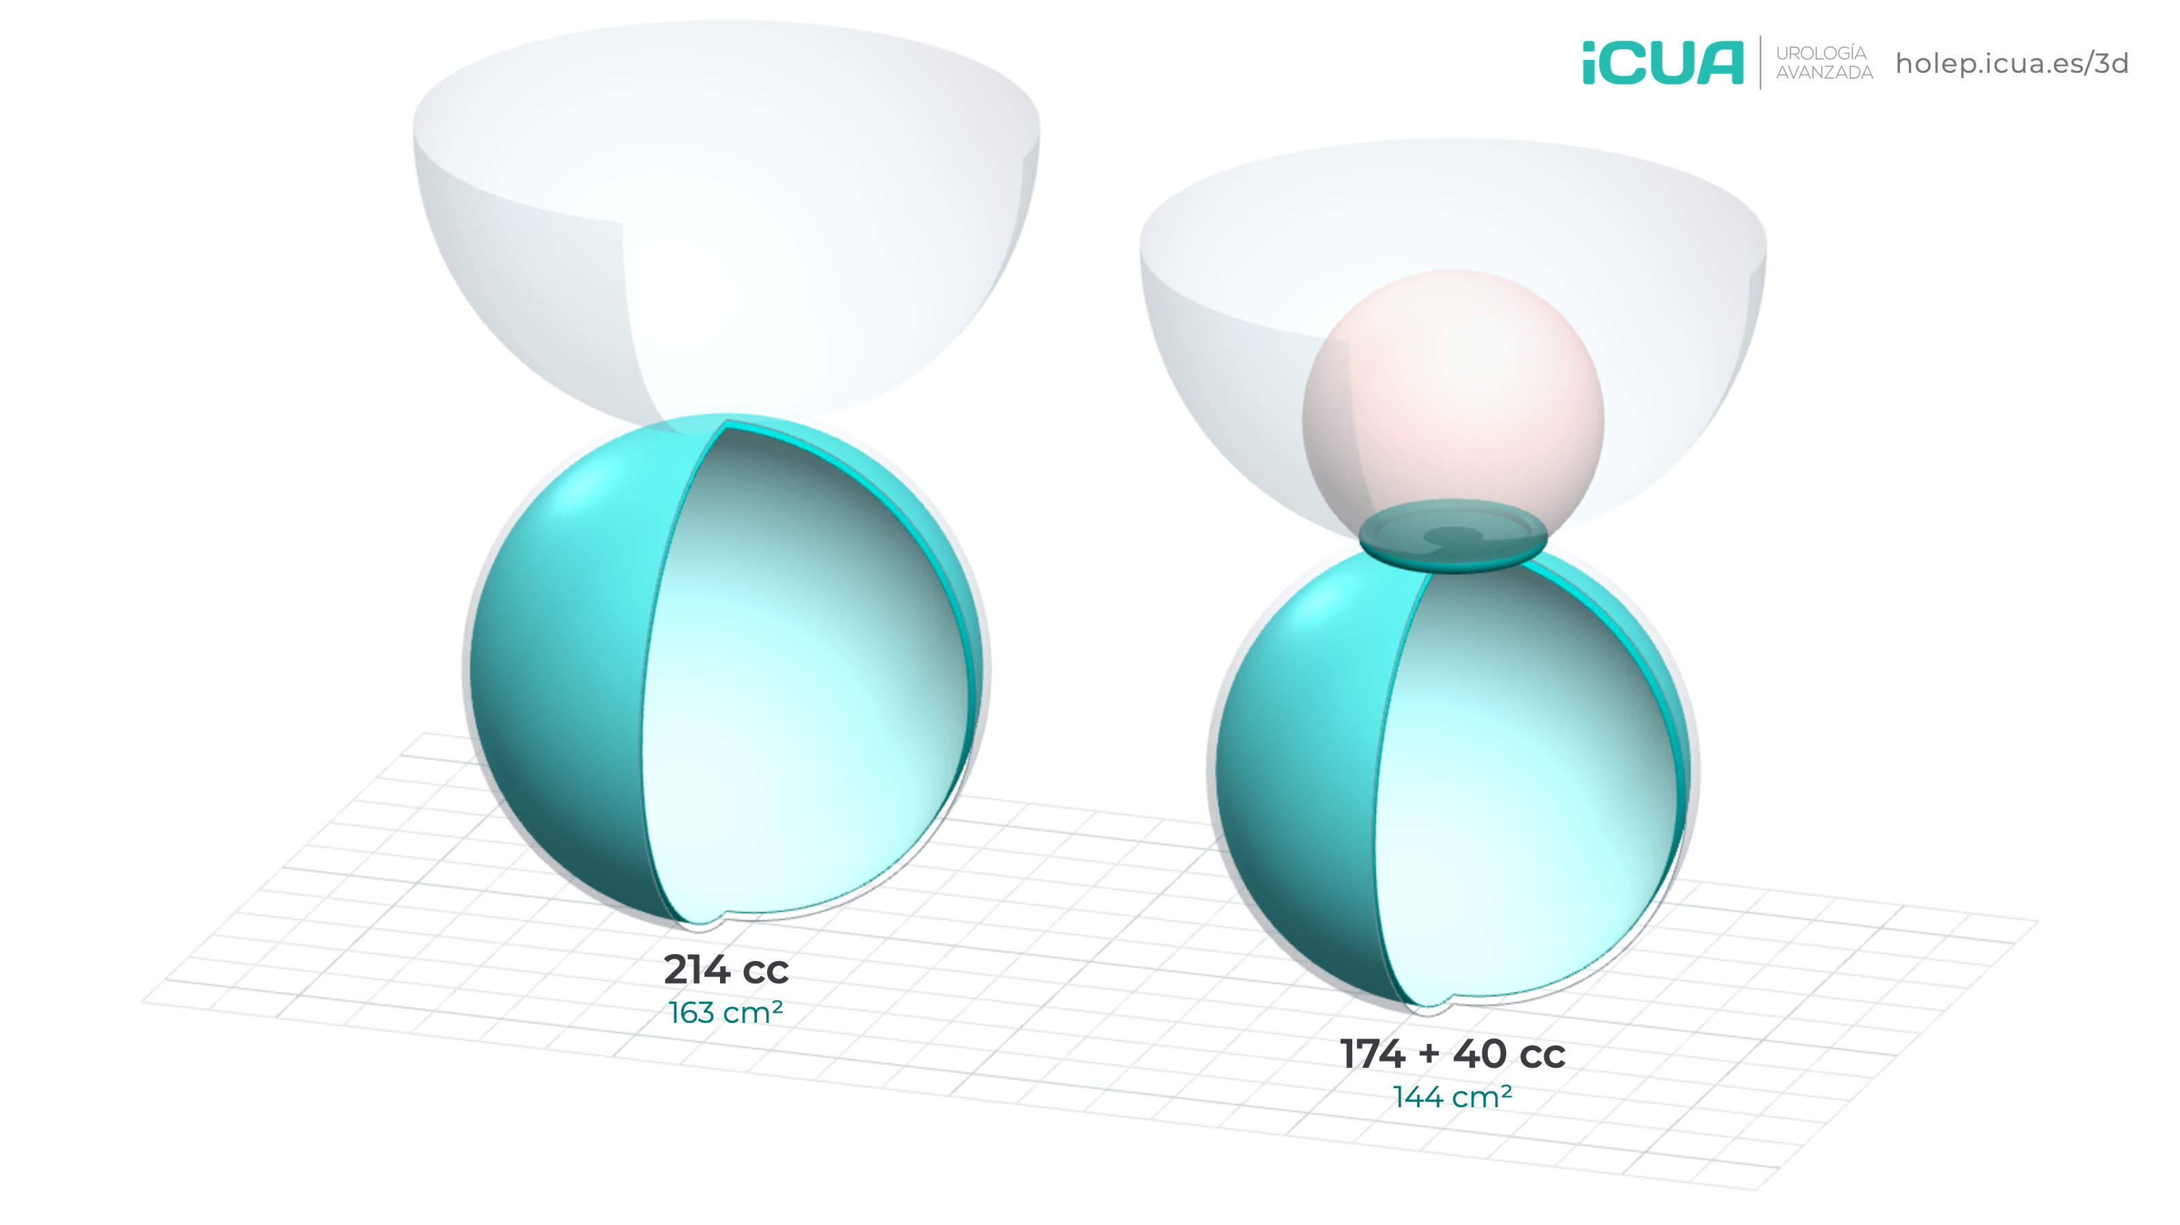
MEDIAN LOBE
Total volume and median lobe
Choose the volume of the lateral lobes and of the median lobe. The median lobe grows into the bladder lumen, covered by urothelium, and only adds its base at the bladder neck to the dissection plane. So for the same total volume, a prostate with a large median lobe has less surface area to dissect than one without.
+4.5 cm²
Base at the neck: added dissection area
163 → 144 cm²
Dissection area · 214 cc
■ Median lobe, covered by urothelium
https://holep.icua.es/3d/en/ · Dr. Fernando Gómez Sancha · ICUA
5 / 7

Slide 6
SIZE INDEPENDENCE
Method and assumptions
Peripheral zone
The peripheral zone, the surgical capsule, is not enucleated. It is assumed to weigh about 20 g in every prostate: the adenoma is the total volume minus 20 cc, and the enucleation plane is the surface of that adenoma. That is why the fair comparison is with the adenoma removed, not with the total volume.
Model limits
Large prostates are often elongated and asymmetric, which changes the absolute figures but not the growth law. Morcellation does increase with volume; this page covers enucleation only.
Volume
Ultrasound ellipsoid formula: V = d1 × d2 × d3 × 0.52. To isolate the effect of size, the equivalent prostate with three equal diameters is used.
Median lobe
A sphere emerging through the bladder neck on a base of 1.2 cm radius. This is a simplification: in some glands the stalk widens with size. A large median lobe can hinder the view of the neck or lie close to the ureteric orifices; the model addresses the dissection plane only.
Dissection plane
Approximated by the surface area of the adenoma: S = π × d². As long as the shape is preserved, any shape follows the same law: surface area scales with d² and volume with d³.
https://holep.icua.es/3d/en/ · Dr. Fernando Gómez Sancha · ICUA
6 / 7

Slide 7
LEARN MORE
HoLEP videos and guides
ICUA material for patients and urologists.
Patient guide
Downloadable guides about HoLEP and recovery after surgery.
holep.icua.es/en.html
Patient videos
Short explanations about the operation and recovery.
holep.icua.es/videos/en/
En bloc HoLEP video library
Surgical videos of en-bloc HoLEP, for urologists.
holep.icua.es/library/
Educational material based on a geometric model. It does not replace a consultation with your urologist.
Free for teaching and outreach, citing the source: ICUA · holep.icua.es/3d
https://holep.icua.es/3d/en/
https://holep.icua.es/3d/en/ · Dr. Fernando Gómez Sancha · ICUA
7 / 7

